Slide 1

Masked Unmasked Face Recognition
By Group 4
Reporter: Cai Rui

Slide 2

Catalogue
Introduction of group members
Beginner Level and Expert Level
Bonus Level——MUFM

Slide 3

1. Introduction of group members

Slide 4

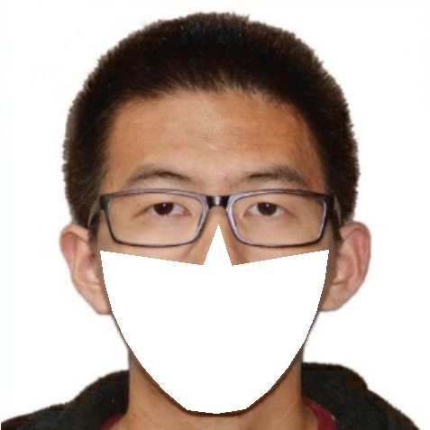
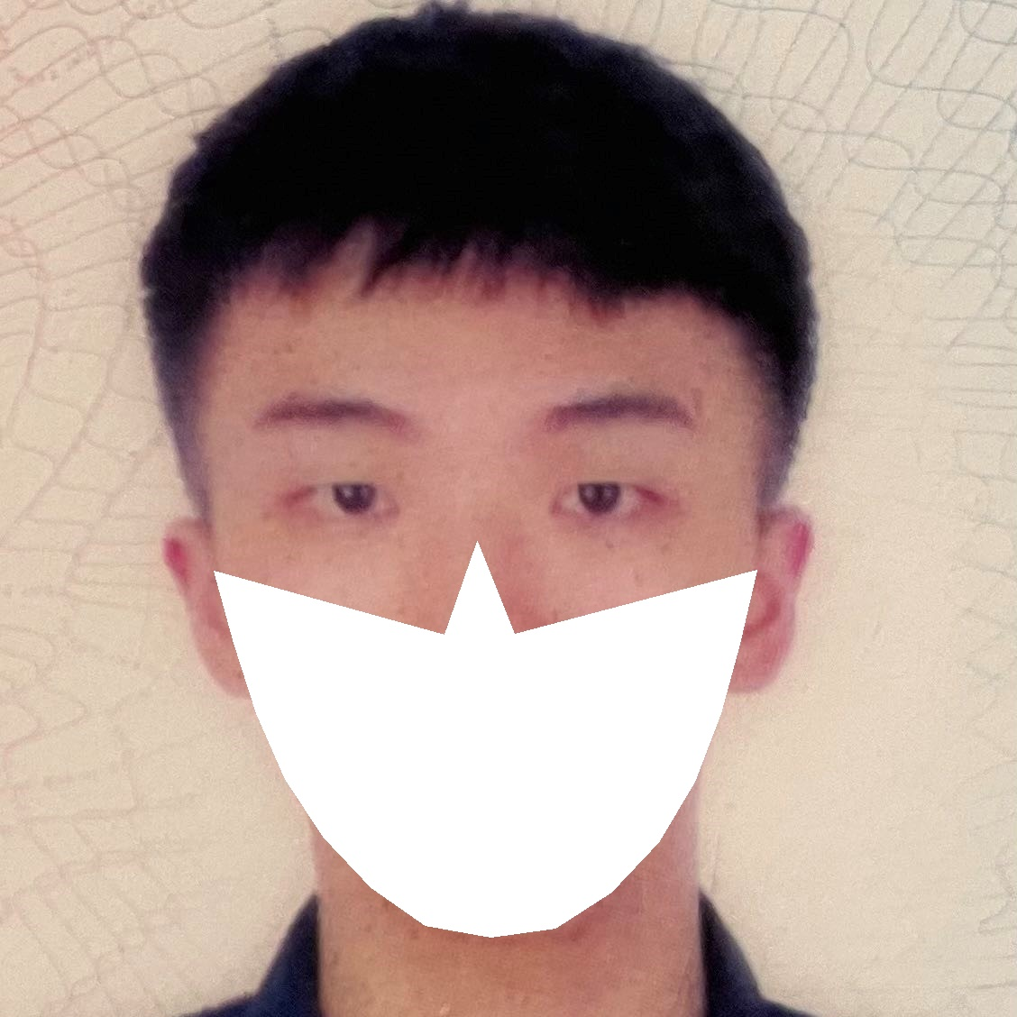
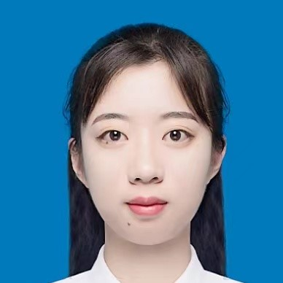
Introduction of Group Members
Name: Cai Rui
School: Xi’an Jiaotong University
Major: Artificial Intelligence
Name: Guo Runfan
School: Xi’an Jiaotong University
Major: Artificial Intelligence
Name: Huang Rizhuo
School: Xi’an Jiaotong University
Major: Artificial Intelligence
Name: Long Yaqin
School: Xi’an Jiaotong University
Major: Control science and engineering

Slide 5
2. Beginner Level and Expert Level

Slide 6
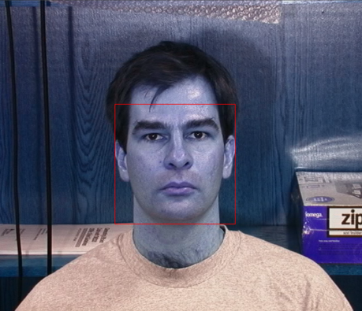
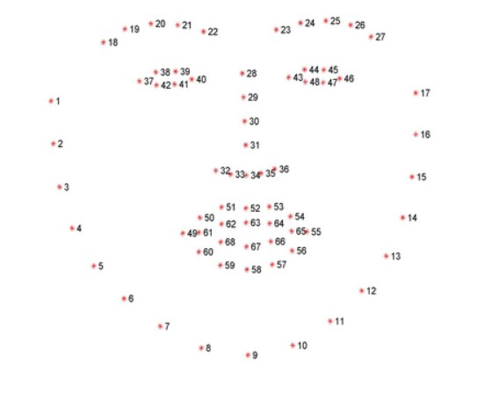
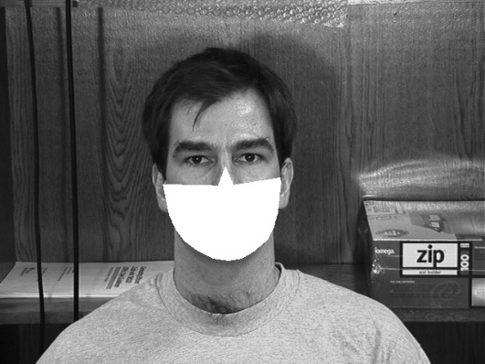
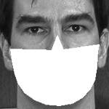
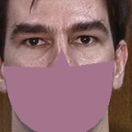
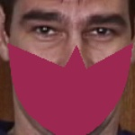
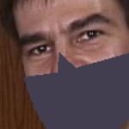
Beginner level
dlib
gray
resize
Maybe other colors
PCA, Gaussian Blur
SVC
With totally white masks, the accuracy that we get is 100%.
With the masks of different colors, the accuracy is 95%.

Slide 7
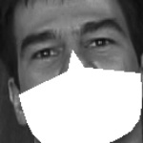

Expert level
1. Face recognition for faces WITHOUT masks
With face_recognition package, we get an accuracy as 93%
2. Face recognition for faces WITH masks
Method 1: Extract human eyes features
2.1 pre-processing
2.1.1 For some pictures which can not be extracted, we use eye-detection and PCA to revolve the pictures.
2.1.2 We add random flips for the masked faces dataset

Slide 8
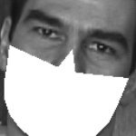
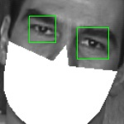

Expert level
2.2 Eye detecting and features encoding
Detect eyes
Use face_recognition to encode the faces
Accuracy = 75%

Slide 9
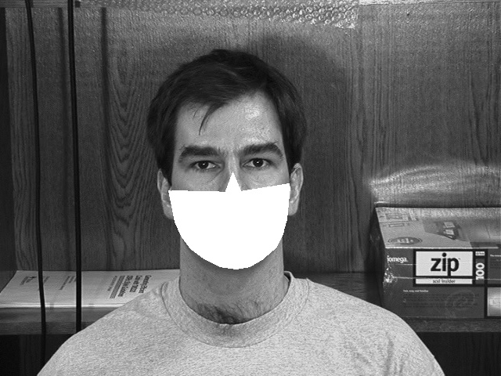
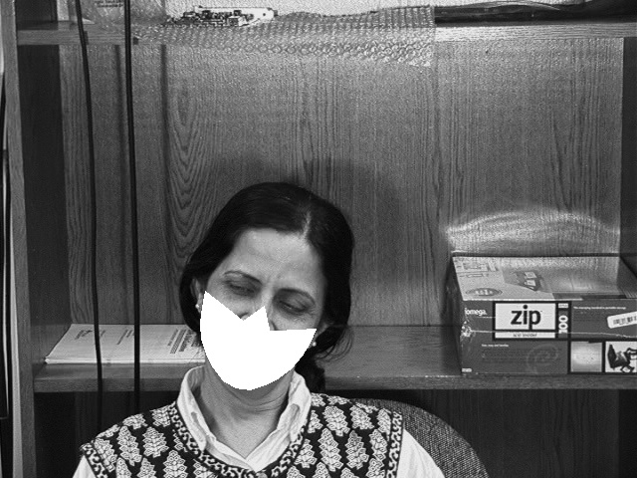
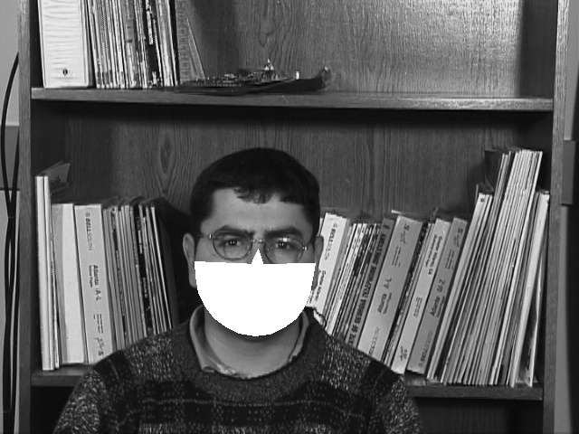
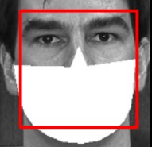
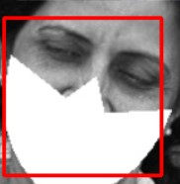
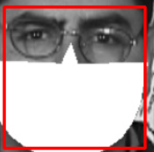
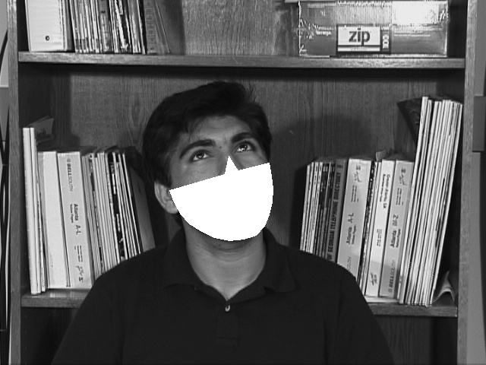
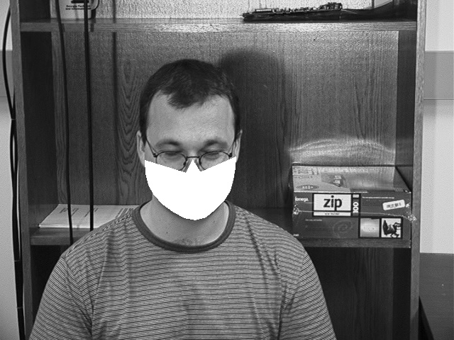
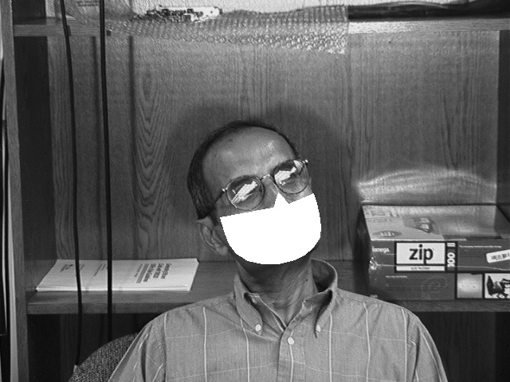
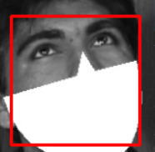
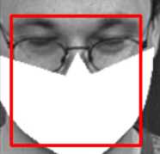
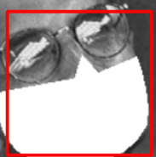
Expert level
Method 2: Train a detector by ourselves to detect the face with mask
Detect masked face
Use face recognition to encode the face and compare with known faces
Accuracy = 70%

Slide 10
Expert level
Flowchart:
Accept
Input picture
unmasked
Face_recognition classifier
Reject
Preprocessing
face&mask detection
Face_recognition classifier
Accept
masked
Reject
Adjust the face
Accept
Face_recognition classifier
Reject

Slide 11
3. The Bonus Level : MUFM
Using HOG+SVM for classification

Slide 12

The Bonus Level : MUFM
Eye Locations
CascadeClassifier
Haar-like Features
PCA
Adaboost Classifier

Slide 13
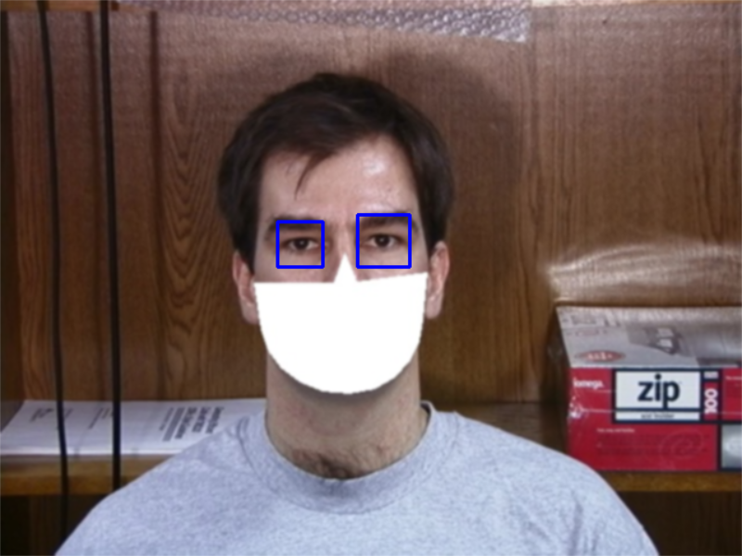
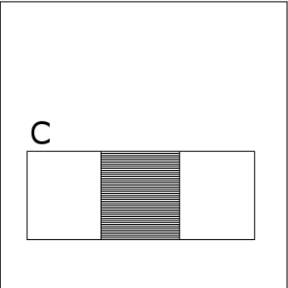
The Bonus Level : MUFM
Eye Locations
CascadeClassifier
Gaussion Blur
Extract Features
EqualizeHist
Haar-like Features
PCA
Adaboost Classifier

Slide 14
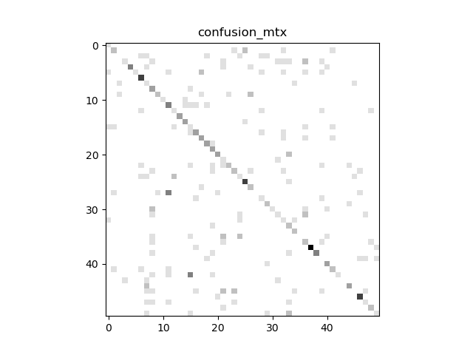
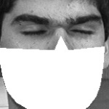
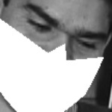
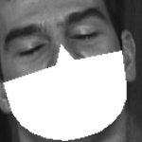

Eye Features: Results
TraingSet Unmasked: 12*50 TestingSet Masked: 3*50
Accuracy : 49.1%

Slide 15
The Upper Part of the Face
Eye Locations
The Upper Part
CascadeClassifier
Tilt the Face
Haar-like Features
HOG Features+PCA
PCA
SVM
Adaboost Classifier

Slide 16
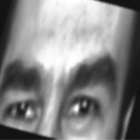
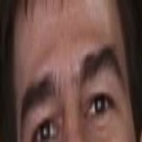
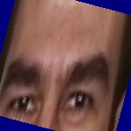
The Upper Part of the Face
The Upper Part
Adjust the Face
Gaussion Blur
Extract Features
EqualizeHist
HOG Features
PCA
SVM

Slide 17
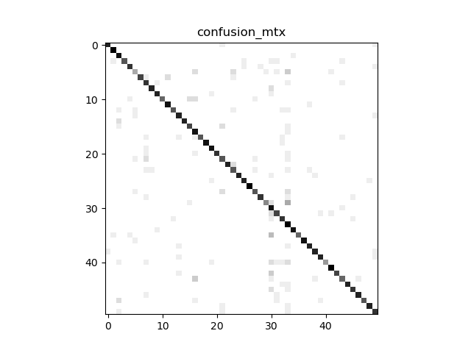
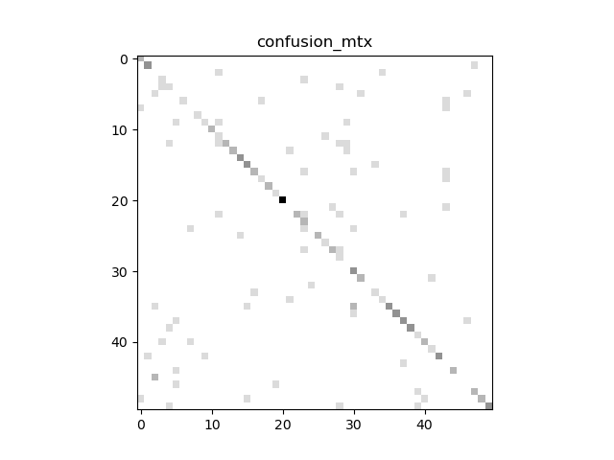
The Upper Part of the Face:Results
TraingSet Unmasked: 12*50 TestingSet Masked: 3*50
Accuracy : 79.9%
Accuracy : 60.3%
Georgia Tech Face Database
CeleBA Datebase

Slide 18
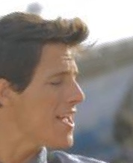
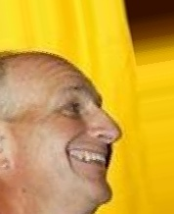
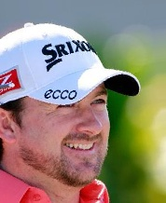
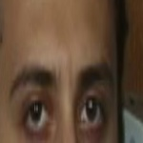
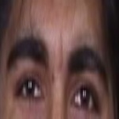

The Upper Part of the Face:Results
Pictures of Wrong Classifications
+ The Side Faces Cannot be detected
+ Some Classifiers have high similarity in upper part of face
+ Eyeglasses

Slide 19
Thank you for your attention!

